Slide 1
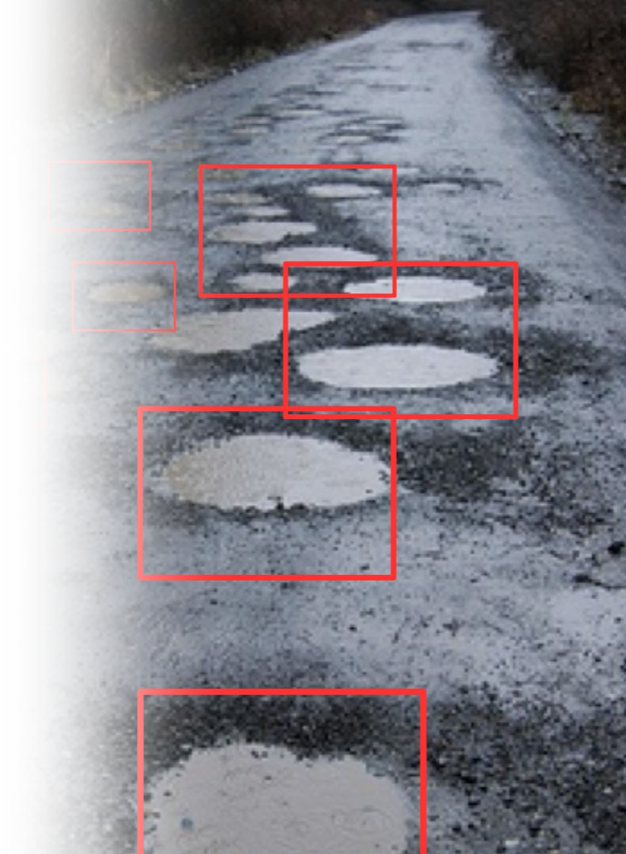
Advanced Pothole Detection for Autonomous Vehicles
Leveraging Computer Vision and Machine Learning for Enhanced Road Safety.
TEAM:
P.VIVEK REDDY -SE22UARI122
P.SAI SARVANI -SE22UARI127
P.VARSHIKA -SE22UARI124
N.VIGNESH -SE22UARI108
N.SHIVANI -SE22UARI109

Slide 2
Introduction to Autonomous Vehicles
Current State:
The Oversight:
Autonomous vehicles excel in navigation, obstacle avoidance, and traffic management.
Limited capability in handling poor road conditions, especially roads with potholes.
Primarily designed for well-maintained urban and suburban roads.
Potholes pose significant risks of damage and accidents, unaddressed in current systems.
Problem Statement
Overview:
Challenges:
Potholes pose significant risks, causing vehicle damage and accidents, which can disrupt the reliability and safety of autonomous driving.
Existing datasets for pothole detection are sparse and lack variety, limiting the effectiveness of training robust detection models.
Computational resources required to train complex models are often beyond the capacity of standard personal computing devices.
Effective autonomous systems require not just pothole detection but precise localization to enable real-time avoidance maneuvers.

Slide 3
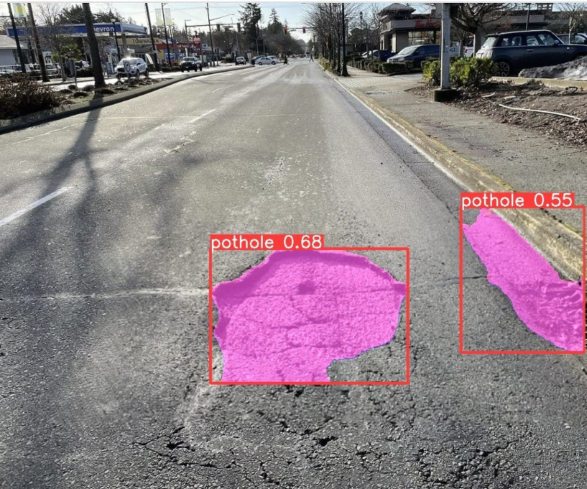
Initial Goals and Approach
Objective:
Develop a machine learning model capable of reliably detecting and classifying potholes based on dashcam footage from vehicles.
Approach:
Use convolutional neural networks (CNNs) to process and classify images, setting the foundation for further development into localization tasks.

Slide 4
Dataset Overview
1
Title: Nienaber Potholes #1 Simplex
Source: Kaggle Dataset
A curated collection of high-quality dashcam images designed to train and validate pothole detection algorithms for autonomous vehicles.
2
Content Details:
Total Images: 3,779 images divided into 1,120 positive samples with potholes and 2,659 negative samples without potholes.
Image Quality: All images are high-resolution dashcam photos, offering clear visibility and detail necessary for accurate pothole detection.
Labeling and Annotations: Each positive image is accompanied by a corresponding annotation text file detailing potholes' locations and dimensions. We converted these annotations from text files into a structured CSV format to streamline the model training process.
3
Preprocessing and Usage:
Cropping: Removed unnecessary areas from images, such as the car dashboard and sky, to focus the model's attention on the road surface where potholes are present.
Bounding Box Adjustment: Adjusted the bounding boxes in line with the cropped images to ensure the annotations remained accurate and relevant for training detection models.
Data Quality: As the images were already of high quality and preprocessed, there was no need for additional noise removal or enhancement techniques, allowing us to focus on the core tasks of detection and localization.

Slide 5




Developing the Initial CNN Model
Programming Environment & Libraries:
Python: Used for its strong data manipulation and machine learning capabilities.
OpenCV (cv2): Handles image processing tasks such as reading, resizing, and preprocessing images.
NumPy: Manages array and matrix operations critical in image and data processing.
TensorFlow/Keras: Frameworks for building and training the CNN. Keras simplifies operations like model layer creation and training.
Scikit-learn: Used for data splitting, class weight computation, and performance evaluation via confusion matrices.
Matplotlib & Seaborn: Visualize data and model performance, essential for analyzing training outcomes and model accuracy.
Model Development & Training
ImageDataGenerator: Enhances data variety through augmentation techniques like rotation and flipping, improving model generalization.
1
EarlyStopping: Prevents overfitting by halting training when validation performance plateaus.
Adam Optimizer: Efficiently handles optimization, especially useful for large datasets with noisy gradients.
Model Architecture:
2
CNN Layers: Multiple convolutional and max-pooling layers, followed by dense layers with ReLU activation, and a softmax output layer for class probability.
Preprocessing & Evaluation:
3
Image Standardization: Resizing to 300x300 pixels and normalizing pixel values to [0, 1].
Confusion Matrix: Summarizes model performance, helping gauge accuracy, precision, and recall.
4
Practical Implementation:
Prediction Function: Enables the model to evaluate new images, illustrating practical usability and effectiveness.

Slide 6
Motivation for Advancing to MobileNetV2
Limitations of the Initial CNN Model:
1
The initial model was efficient in classification but lacked spatial resolution for pinpointing exact pothole locations.
Why MobileNetV2:
2
Chosen for its lightweight architecture and speed, making it ideal for deployment in mobile or edge computing scenarios where real-time processing is crucial.
Goals for Enhancement:
3
Enhance the system to not only detect but also localize potholes, providing critical information for navigation and driver assistance systems.

Slide 7
Advancing to MobileNetV2 for Localization
Programming Environment & Key Libraries:
Model Architecture & Training:
Dataset Preparation:
Python & OpenCV: Utilized for essential image processing tasks such as reading, resizing, and normalization.
Base Model:
Data Source: The dataset is loaded from a CSV file containing bounding box coordinates and image paths.
MobileNetV2 pretrained on ImageNet serves as the backbone. The model is modified by excluding the top layers and adding custom layers for localization tasks.
TensorFlow/Keras: Frameworks for building, training, and evaluating the MobileNetV2 model.
Preprocessing:Images are resized to 224×224224×224 pixels and normalized to a range of [0, 1].Bounding box coordinates are scaled according to the new image dimensions to maintain spatial accuracy.Utilized a custom preprocessing function to handle bounding box adjustments dynamically.
Custom Layers:Global Average Pooling layer for feature extraction.Dense layers for bounding box regression outputs.Optimized with the Adam optimizer for faster convergence.
Scikit-learn: Used for dataset splitting and evaluation metrics like classification reports and confusion matrices.
Pandas & NumPy: Employed for efficient data manipulation and numerical operations.
Callbacks:ReduceLROnPlateau to dynamically adjust the learning rate based on validation performance.
Train-Test Split: The dataset is divided into training and testing subsets using an 80-20 ratio.
Matplotlib: For visualizing training progress and data exploration.
Training Strategy:
Model Evaluation:
Visualization of Training Outcomes:
Loss Function: A custom loss function combines Mean Squared Error (MSE) for bounding box regression.
Metrics: The model is evaluated using loss and accuracy. Accuracy is measured by checking predicted bounding boxes against ground truth within a 20-pixel tolerance. Results: The model achieves 38.83% accuracy in correctly predicting the bounding box location.
Display training and validation accuracy and loss over epochs to illustrate learning progress and model behavior under different conditions.
Validation Monitoring: Early stopping is applied to prevent overfitting by monitoring validation loss over a fixed number of epochs.
Augmentation:Includes techniques like rotation, flipping, and scaling to increase model robustness.

Slide 8
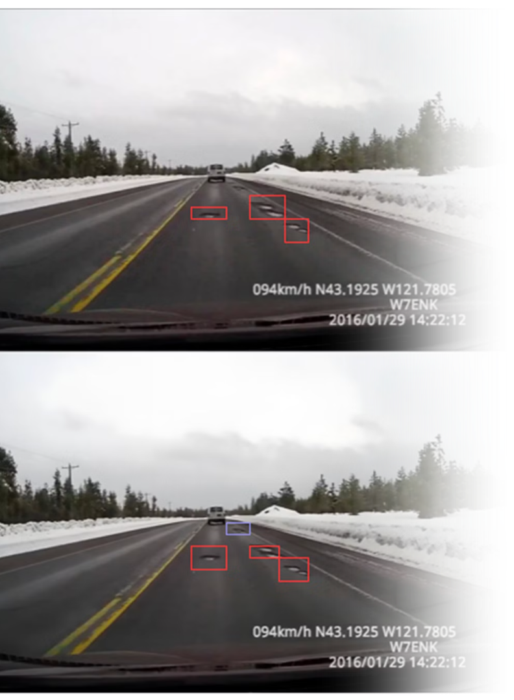
Preparing for Transition to Faster R-CNN ResNet50 FPN
1
Motivations for Exploring Faster R-CNN ResNet50 FPN:
To address the need for higher accuracy and faster processing in dynamic driving conditions where detection speed can be critical.
2
Advantages of Faster R-CNN ResNet50 FPN:
Utilizes a sophisticated region proposal network that improves the precision and speed of object detection.
3
Research Goals:
Investigate the adaptation of Faster R-CNN to enhance both detection and localization accuracy, focusing on reducing latency and increasing reliability under varied environmental conditions.

Slide 9
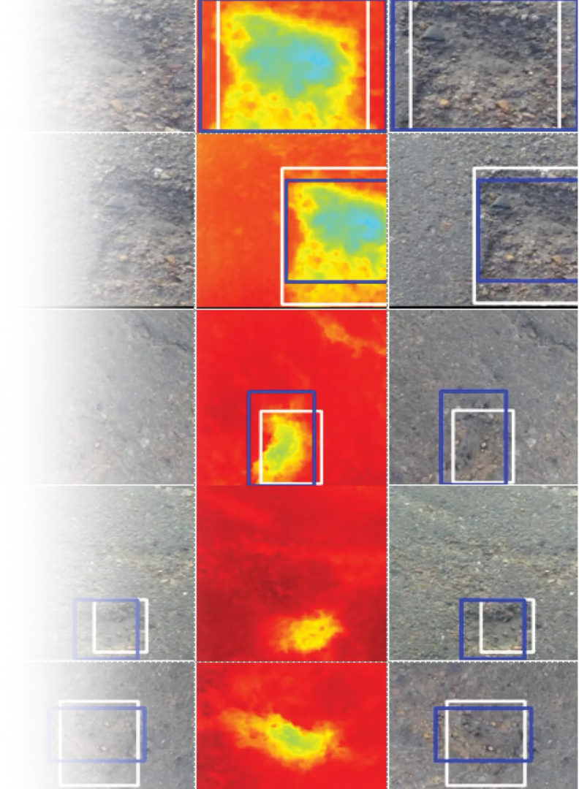
Exploring Implementation of Faster R-CNN ResNet50 FPN
1
Considering Faster R-CNN ResNet50 FPN for Enhanced Detection
Evaluating Faster R-CNN's potential to meet the high-performance demands of real-time pothole detection in autonomous vehicles.
2
Research on Sliding Window Approach
Exploring the sliding window technique to process large images in manageable patches, improving training efficiency and focusing on localized features more effectively.
3
Future Directions and Potential Implementation
Plan to conduct pilot tests with Faster R-CNN, assessing its real-world efficacy in detecting and localizing potholes. This includes simulation tests in dynamic driving simulations to mimic real-world conditions.

Slide 10
Research and Development
Future Enhancements:
Explore algorithmic improvements and adaptive learning techniques to further enhance accuracy under varied environmental conditions.
Collaborative Opportunities:
Seek collaboration with automotive manufacturers and software developers for further development and deployment.
Research and Publication Intentions:
Planning to document our advancements in a research paper, sharing our findings with the scientific and engineering communities to contribute to ongoing developments in autonomous vehicle technologies.
Future Research Opportunities:
The field offers substantial opportunities for further research. We are committed to refining our detection systems and exploring new technologies to enhance accuracy and reliability.

